Slide 1
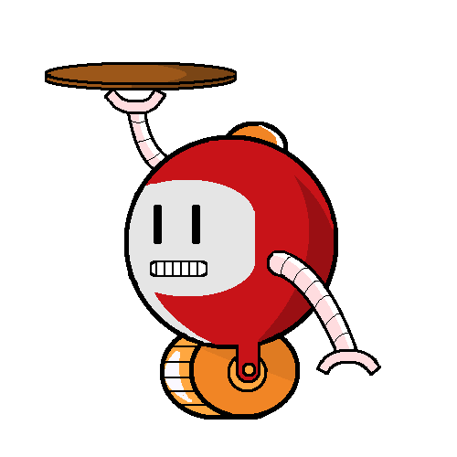
LazyBots
Sfwr eng 4G06A & Tron 4TB6a

Slide 2
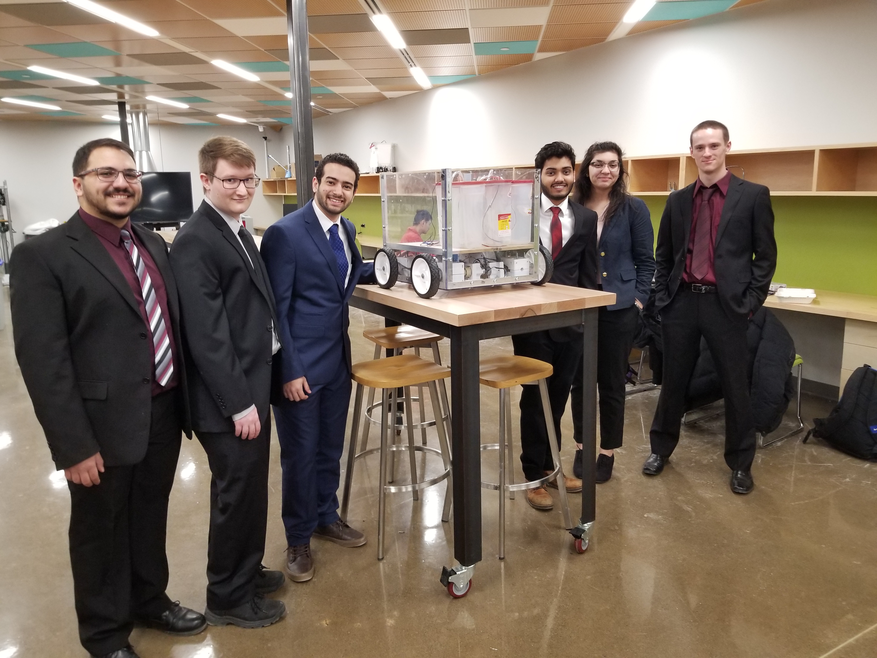
Meet the Team
Karim Guirguis
David Hemms
Marko Laban
Curtis Milo
Keyur Patel
Alexandra Rahman
Alfred

Slide 3
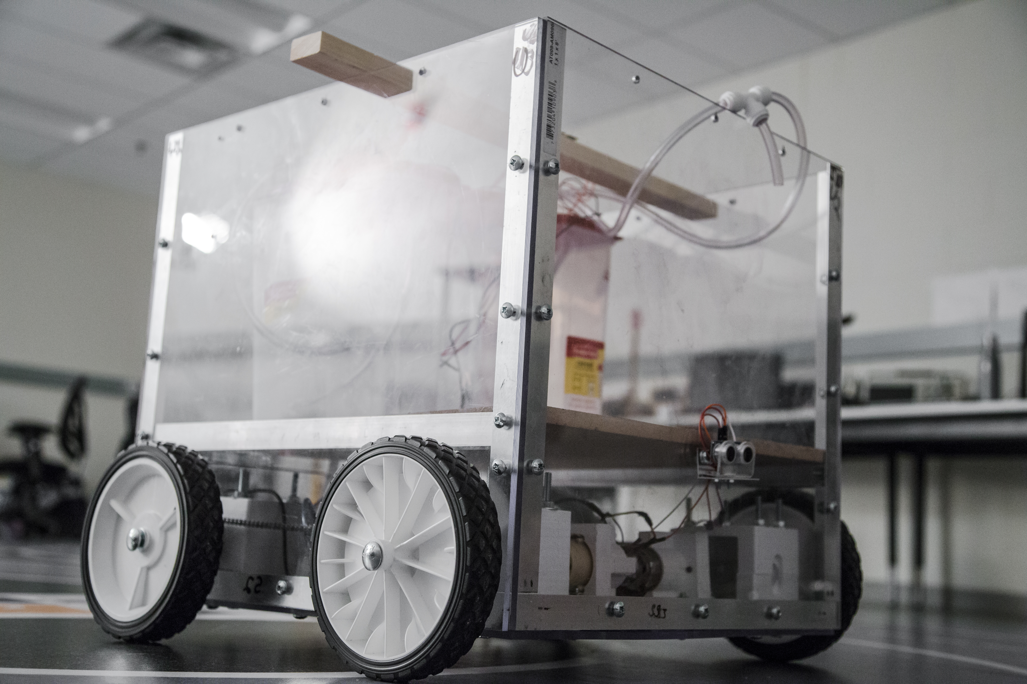
Meet Alfred
A self driving robot
A drink dispenser

Slide 4
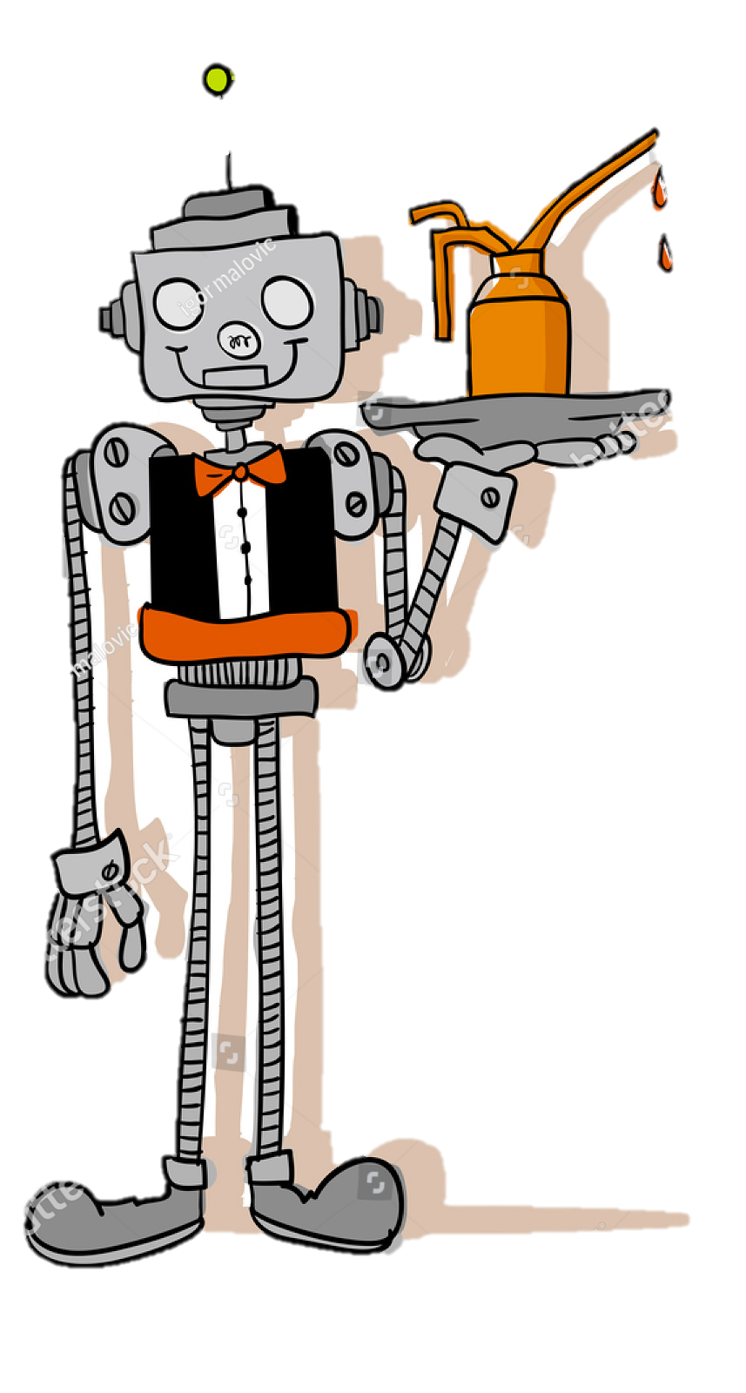
How Alfred Interacts in Social Settings
Restaurant Client
Customer orders a drink
Arrives at table
Drink dispensed

Slide 5
How Alfred Interacts with Staff
Restaurant Staff
Drink Supply Levels
Power Supply Levels
Restaurant Management
Restaurant Layout
Available Drinks
Reports
Call Hoome

Slide 6
Alfred in Action

Slide 8
The Magic Behind Alfred

Slide 9
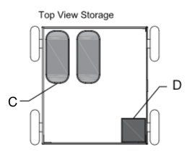
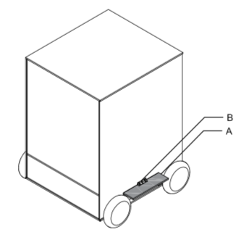
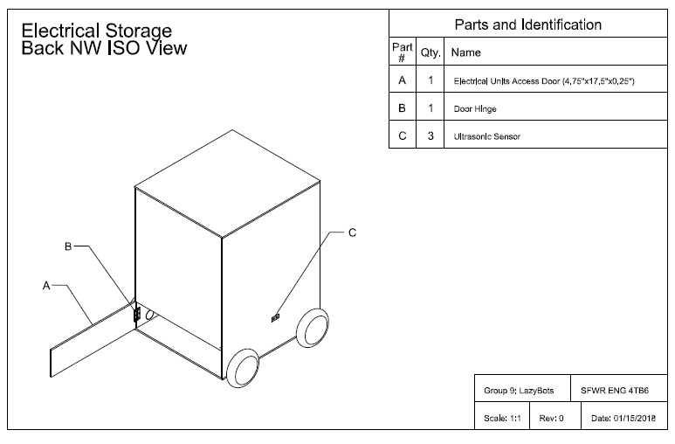
The Mechanical Design

Slide 10
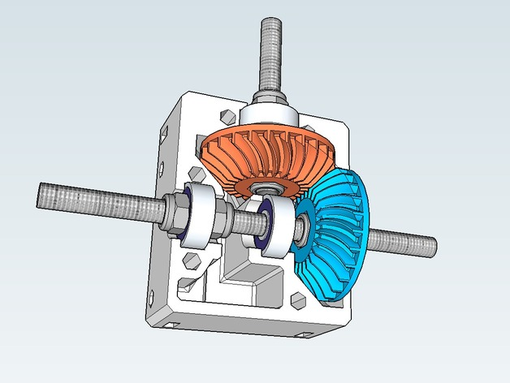
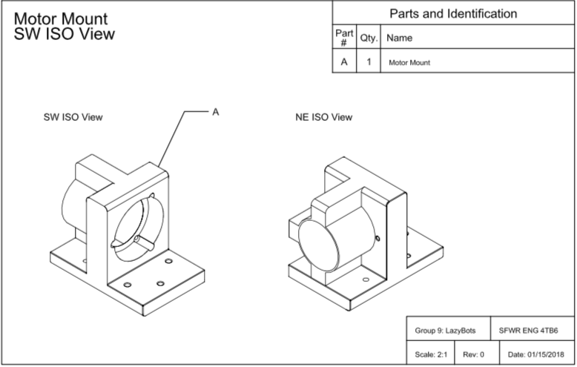
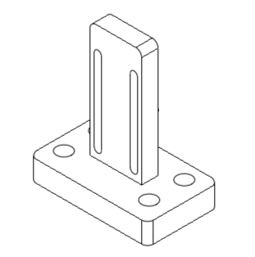
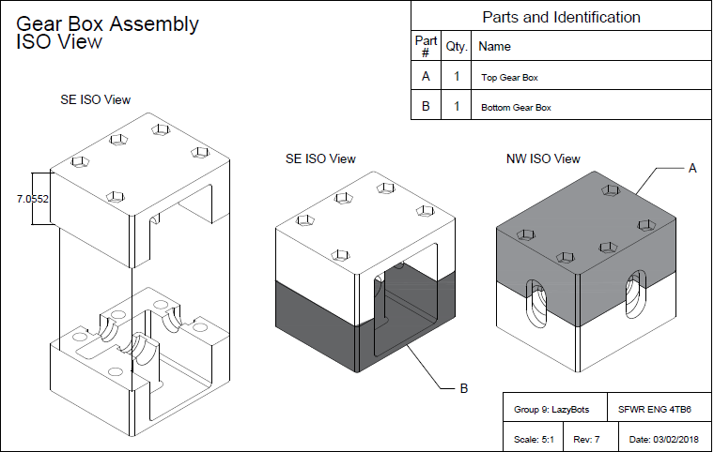
The Mechanical Design

Slide 11
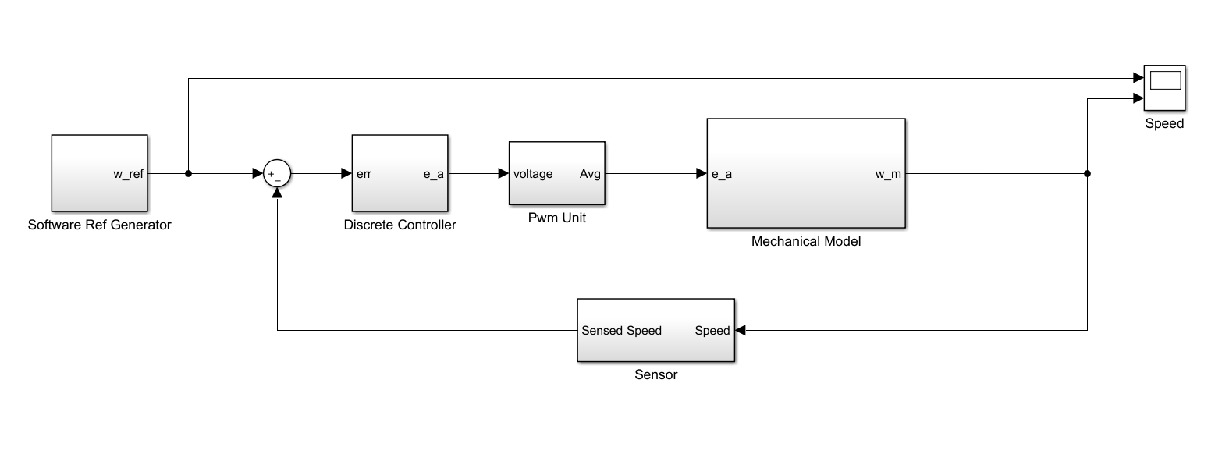
- Motor Control performed using an H-bridge to control voltage through the use of PWM
- Use of ultrasonic sensors to ensure that Alfred will have distance to stop
- Image processing used to track relative location within the restaurant
- Drink pumps Controlled via a separate system via MOSFETS and serial communication
The Embedded Design

Slide 12
Client Application
- User interface that allows the user to manage orders for their table
Manager System
- Allows the staff to change the layout of the map and configure drink types and to call Alfred back to the kitchen
Alfred
- Embedded Software for autonomous navigation and dispensing
Server
- Ties all sub systems together.
- Provides a means of communication between subsystem
- Communication with server is secured using various protocols dependent on user accessing the server
The Software Design

Slide 13
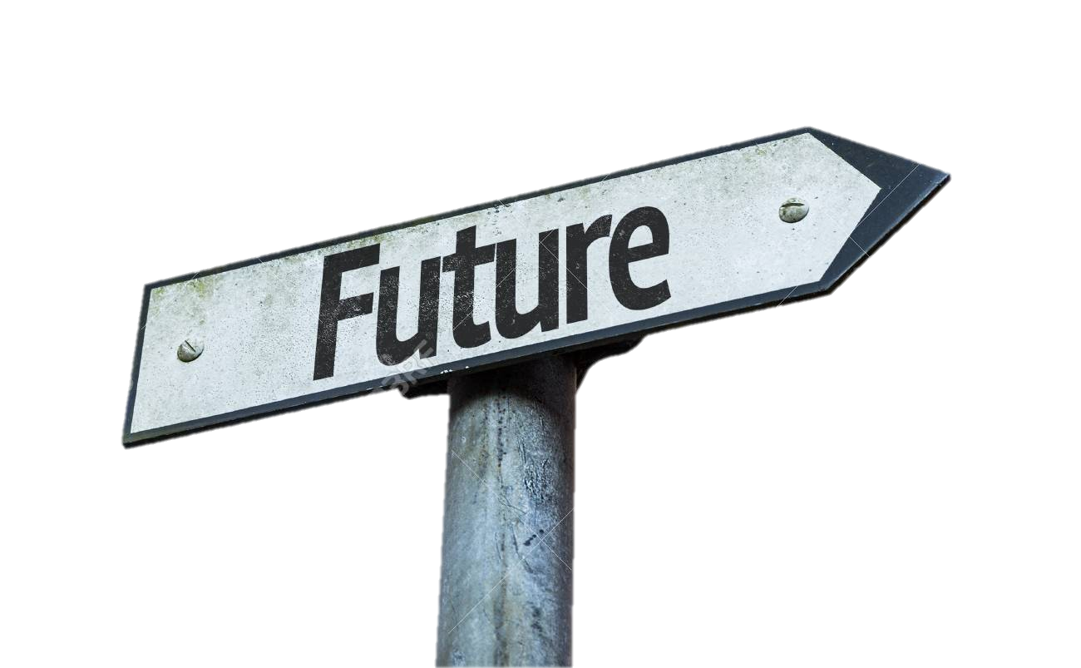
Future Enhancements
Point of Sale Systems
Dispensing System
Questions?

